Slide 1

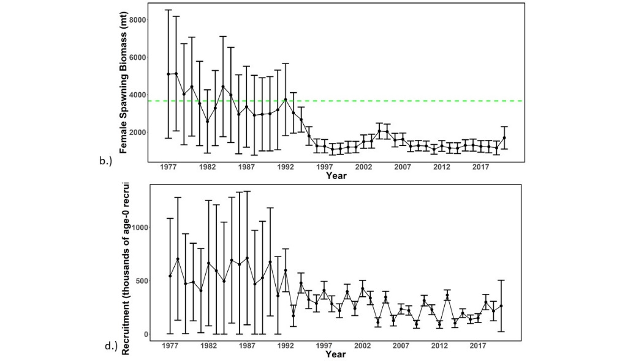
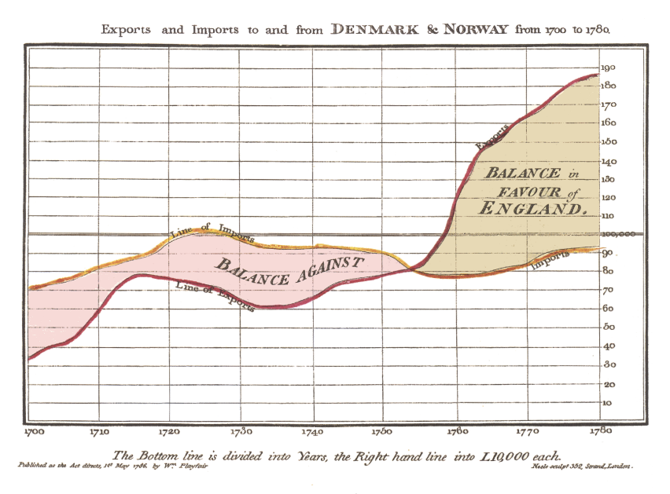
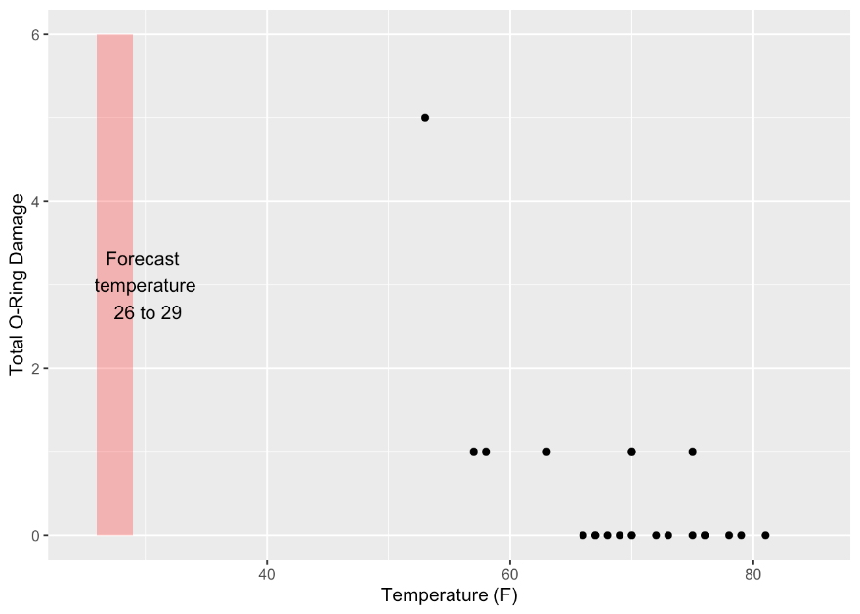

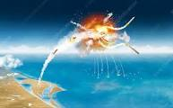

Visualizing Spatial Assessment Models
Jon Brodziak
Pacific Islands Fisheries Science Center
Jon.Brodziak@NOAA.GOV
WCNPO
Striped marlin 2023
Wiliam Playfair ~ 1786
Challenger launch 28-Jan-1986

Slide 2
Outline
Visualizing spatial assessment models supports empirical testing, open debate, documentation, uncertainty and peer review
Hypergraphs provide a way to view polyadic relationships in spatial assessment models – what are they?
Hypergraph structures for spatial models
Hyperedges are spatial domains
Vertices represent objects or nodes
Incidence matrices are node-edge relations
Hypergraphs for assessment structures
Some spatial examples
Conclusion

Slide 3
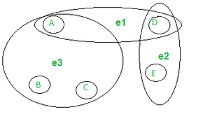
Hypergraphs generalize graphs
A graph G = ( V, E ) is a set of elements called vertices (i.e., nodes, objects), together with a set of edges E = { e_{i} }, each of which are two-element subsets of V, e_{i} = { v_{j} , v_{k} }, e.g. hypercubes
Pairwise (one-to-one) relationships
computer networks & circuit designs
molecular structures
ancestral trees
biological networks …
A hypergraph H = ( V, E ) is a set of vertices, together with a set of hyperedges E = { e_{k} } each of which are subsets of V, where e_{k} = { v_{i} } and i ϵ K, the index set for e_{k}, e.g. 3 hyperedges.
Multiway (many-to-one) relationships
VSLI circuit designs
machine learning & neural networks
image processing
next-item recognition, for ecommerce
co-occurrence networks …

Slide 4
Incidence
Matrix of Relationships
Emails (Edges)
 | E1 | E2 | E3
Amy | X | X
Kyle | X
Carl |  | X | X
Dan |  | X | X
Jane |  | X | X
Email
Users
(Nodes)
Graph model
Hypergraph model
Kyle
E1
Kyle
E3
Carl
Carl
Amy
Amy
Jane
Sue
E2
Dan
Dan

Slide 5
Example 1: Spatial distribution of fishery system objects during spawning season
Objects are: Populations (P₁, P₂), Local (L₁, L₂, L₃) and Commercial (C₁, C₂) Fleets
Hyperedges are: Areas A₁, A₂ and A₃
A₂
Incidence Matrix
L₁
A₁
 |  | Hyperedge Areas
 |  | A₁ | A₂ | A₃
Fishery System Objects | P₁ | 1 | 0 | 0
 | P₂ | 0 | 1 | 1
 | L₁ | 1 | 0 | 0
 | L₂ | 0 | 1 | 0
 | L₃ | 0 | 0 | 1
 | C₁ | 1 | 1 | 0
 | C₂ | 0 | 1 | 1
P₁
C₁
L₂
Members of multiple
hyperedges
P₂
C₂
A₃
L₃

Slide 6
Example 2: Spatial distribution of fishery selectivities during foraging season
Objects are: 2-tuples of Fleets (L₁, L₂, L₃, C₁, C₂) and Selectivities (d=dome, f=flat) as v_{k}=(L_{k}, d(L_{k}))
Hyperedges are: Areas A₁, A₂ and A₃ or associated Environments E₁, E₂ and E₃
(A₂, E₂)
f (C₁)
Vectorized Incidence Matrix
(A₁, E₁)
d (C₂)
 |  | Hyperedge Areas
 |  | A₁ | A₂ | A₃
Fishing Fleet Vertex Element (O₁) | L₁ | d (L₁) | 0 | 0
 | L₂ | 0 | d (L₂) | 0
 | L₃ | 0 | 0 | d (L₃)
 | C₁ | f (C₁) | f (C₁) | 0
 | C₂ | d (C₂) | f (C₂) | f (C₂)
f (C₁)
d (L₁)
f (C₂)
Fleets With
Missing or
Inadequate Size Data
d (L₂)
d (L₃)
(A₃, E₃)
f (C₂)
A Vectorized Incidence Matrix (VIM) has vertices that are
N-tuples of objects (O) where a vertex v = ( O₁, O₂, …, O_{N} )

Slide 7
Example 3: Fishery selectivity mirroring by fleet for the 2015 WCNPO MLS assessment
Objects are: Fleets (f(.)) and “survey” CPUE indices (s(.)) with representative size composition data inside black circles and with flat-topped selectivity in size shaded green.
Hyperedges are: Sets of fleets or indices mirrored to one fleet’s selectivity in yellow figures
Japanese Distant Water Longline
Fleet in Area 2
Japanese Coastal Longline Fleet
Hawaii
Longline Fleet
Japanese Distant Water Longline Fleet in Area 3
f13
Japanese Distant Water Longline
Fleet in Area 1
f4
f16
f5
f2
f14
f3
f6
f7
f15
s16
f1
f18
f8
s15
s3
s4
s2
f9
s7
s8
f10
s6
f11
s9
f12
f17
s10
s11

Slide 8
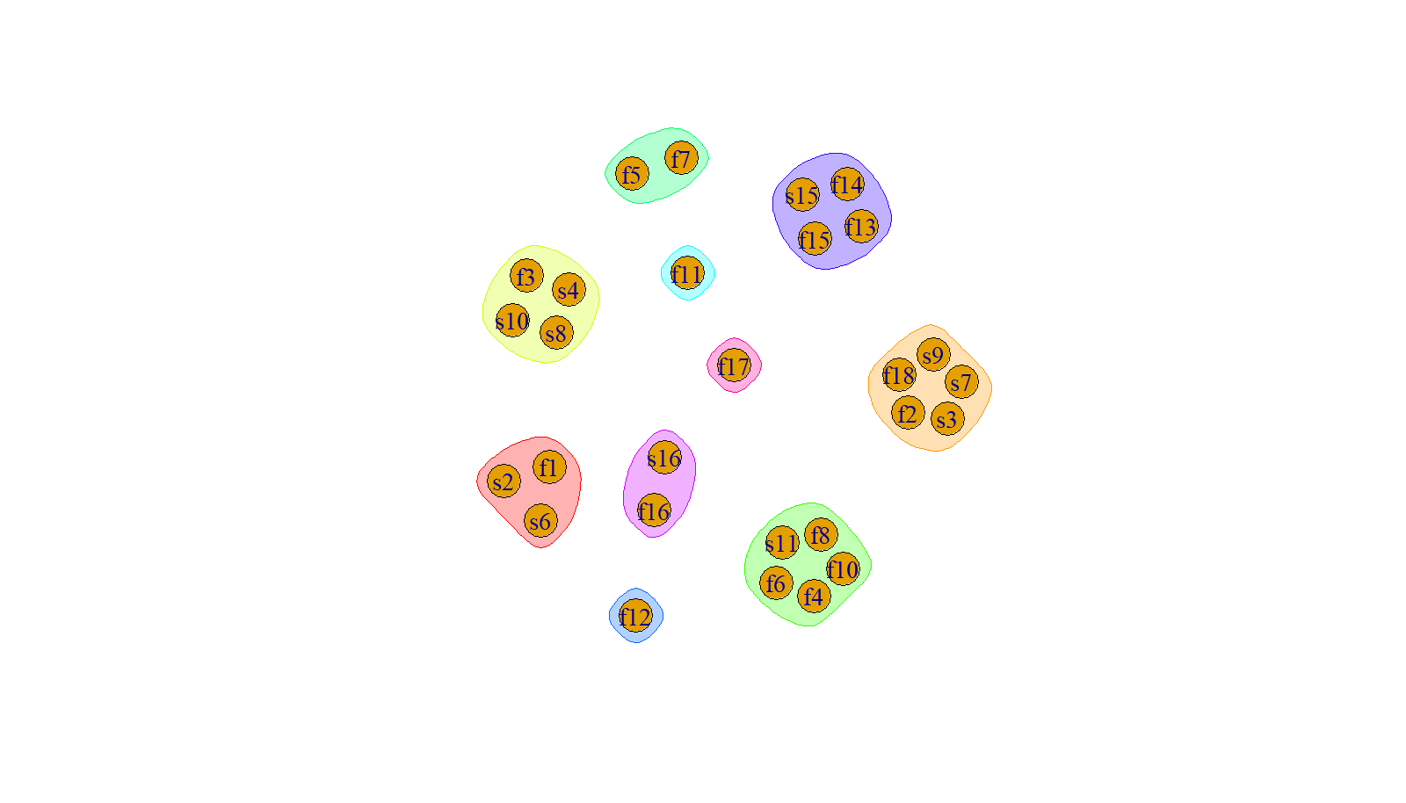
Example 3 continued: Fleets as areas structure used for the 2015 WCNPO MLS assessment
Hypergraph visualization of the structural patterns
Of fishery selectivities
For 18 fishing fleets
And 10 CPUE indices
Using 10 hyperedges
Used in 2015
Japanese
Driftnet Fleet
Taiwanese Longline Fleet
Japanese Distant Water Longline Fleet in Area 3
Japanese Distant Water Longline
Fleet in Area 2
Hawaii Longline Fleet
Japanese Distant Water Longline
Fleet in Area 1
Japanese Coastal Longline Fleet
Visualization with R package “hyperG”

Slide 9
Example 4: Fishery selectivity mirroring by fleet for the 2023 WCNPO MLS assessment
Objects are: Fleets (F(.)) and CPUE indices (S(.)) with representative size composition data inside black circles and with flat-topped selectivity in size shaded green and time-varying selectivity in size shaded in orange.
Hyperedges are: Sets of fleets or indices mirrored to one selectivity in yellow shaded figures
Japanese DWLL
Fleet in Area 1 in Quarter 1
Japanese DWLL
Fleet in Area 3 in Quarter 1
F5
Japanese DWLL
Fleet in Area 2 in Quarter 1
Hawaii
Longline Fleet
F1
F9
F4
F14
F23
F6
F16
F22
F2
F20
F18
F8
F25
F24
F10
F17
F12
S2
F3
F11
F19
S1
F15
S3
S6
F13
F7
S5
S4
F21

Slide 10
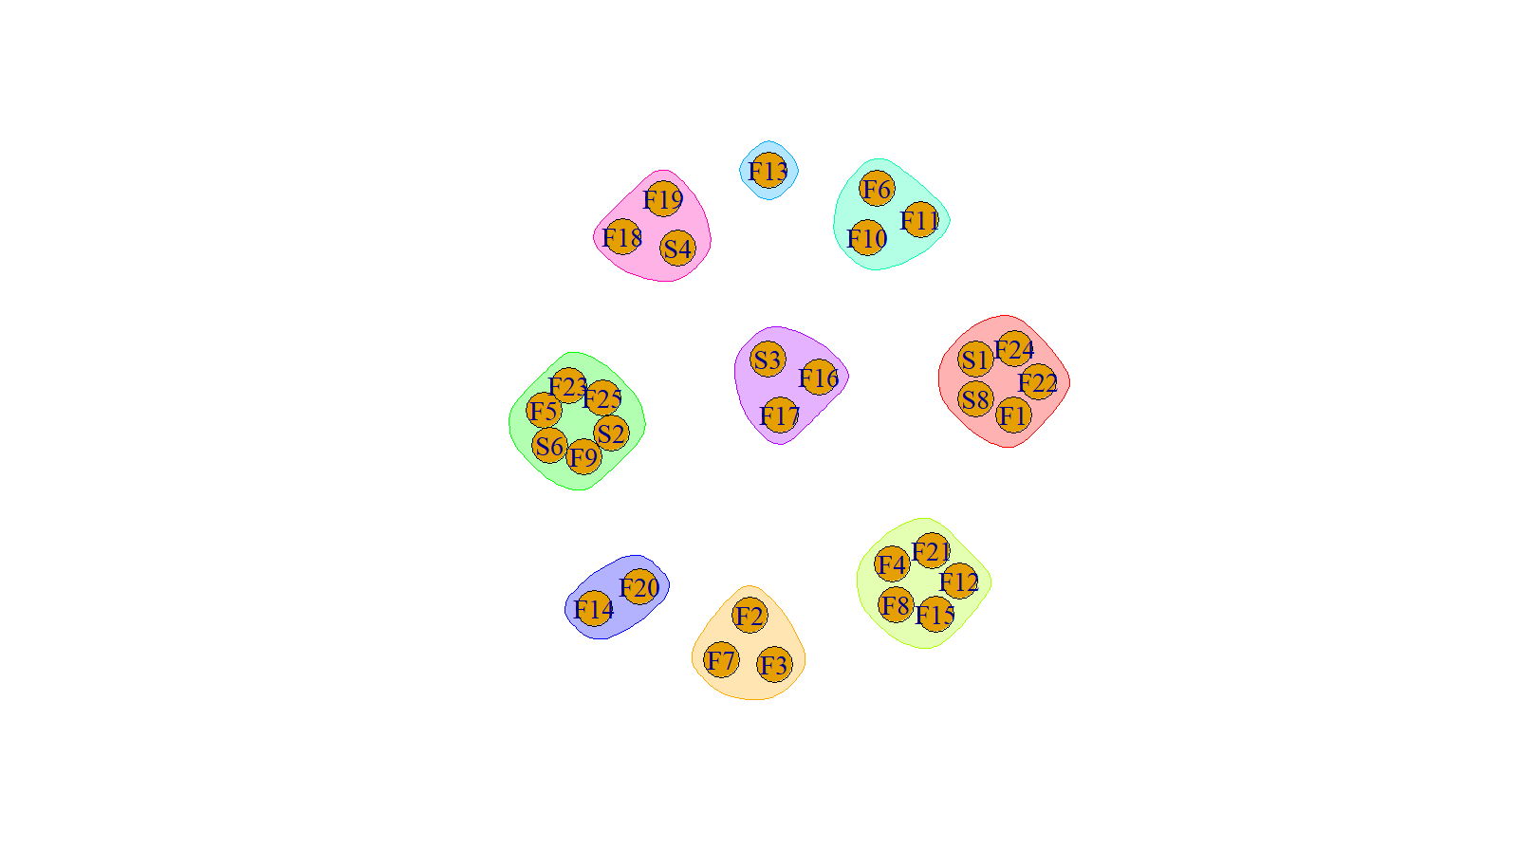
Example 4 continued: Fleets as areas structure used for the 2023 WCNPO MLS assessment
Japanese
Driftnet Fleet In Quarters 1 & 4
Hypergraph visualization
Of the structural patterns
Of fishery selectivities
For 25 fishing fleets
And 6 CPUE indices
With 9 hyperedges
Taiwanese Distant
Water Longline
Fleet
Japanese DWLL
Fleet in Area 1 in Quarter 4
Japanese DWLL
Fleet in Area 1 in Quarter 1
Japanese DWLL
Fleet in Area 1 in Quarter 3
Hawaii
Longline Fleet
Japanese DWLL
Fleet in Area 3 in Quarter 1
Japanese
Driftnet Fleet
In Quarters 2 & 3
Japanese DWLL
Fleet in Area 2 in Quarter 1

Slide 11
Example 5: Model structures for components of region 2 in a hypothetical factorial ensemble model with two uncertainty axes – natural mortality value and fishery selectivity model type
Objects are: 15 individual models M(.) as members of region e₂ in a two-region ensemble model
Hyperedges are: Regions e₁, e₂, Natural mortality rates (n_{(.)}, red), and Selectivity types (s_{(.)}, blue)
Notation: Model M_{IJK} denotes
Region = I
Selectivity type = J
Natural Mortality type = K
Notation: e₂ is region 2 of a 2-region model , n_{(.)} is natural mortality (5 levels), s_{(.)} is selectivity (3 levels)

Slide 12
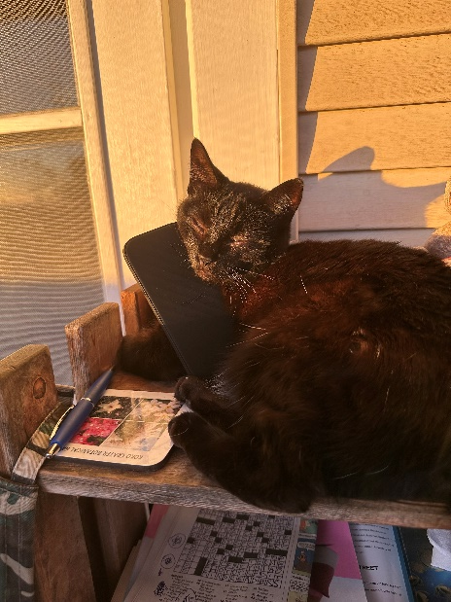
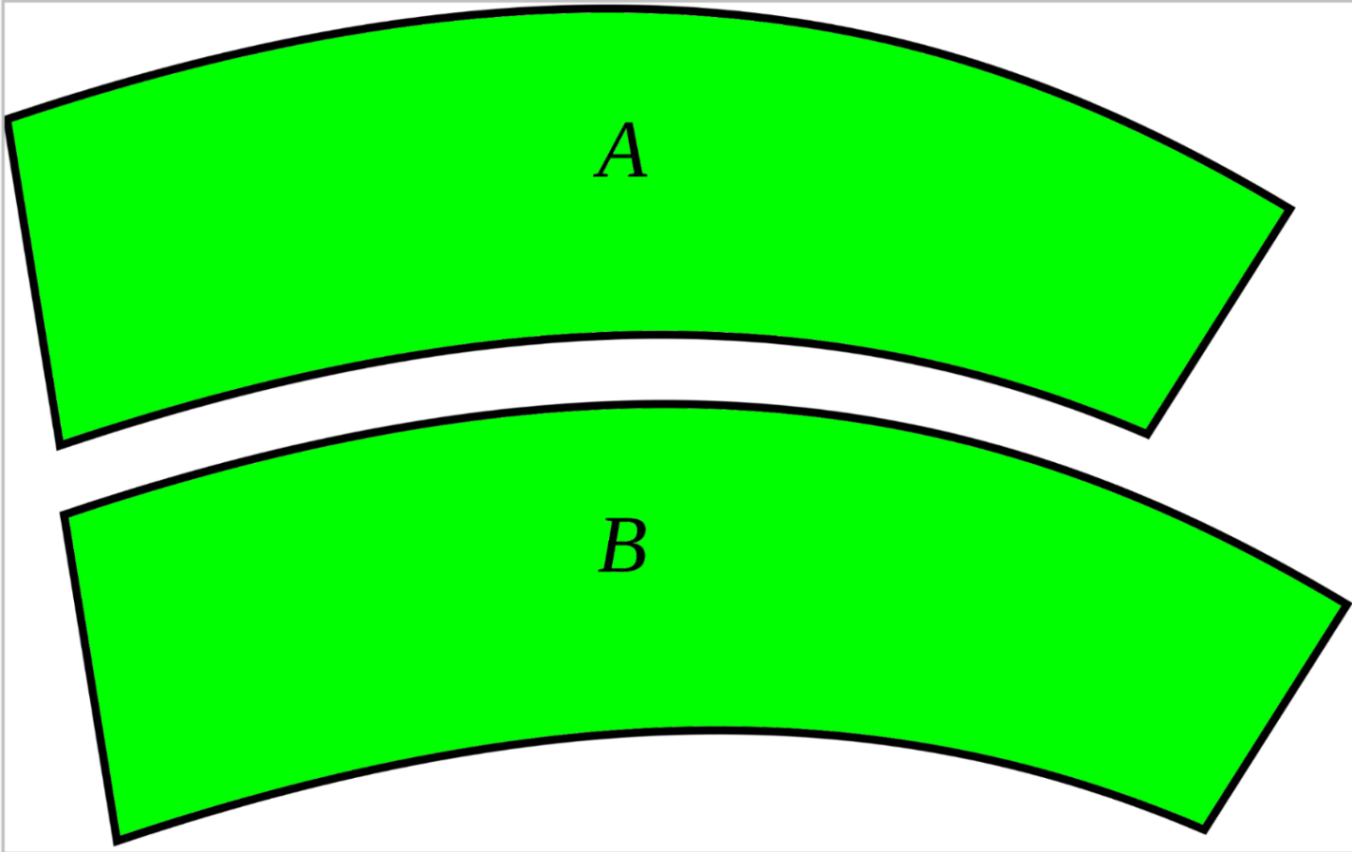
Conclusion
Hypergraphs provide a concise way to represent multiway relationships for modeling spatial systems
Hypergraphs with Vectorized Incidence Matrices can represent pairwise or multiway relationships in spatial assessment models for visualization, model specification and computer representation
Is A = B?
Seeing is not wholly an objective matter depending upon what there is to be seen, but is very considerably a subjective matter depending upon the eye that sees
~ Joseph Jastrow

